Slide 1
International Programme in Performance Analysis of Sport,
Szombathely, 5th May – 16th May, 2012.
IPPAS
2013

Slide 2

PARCS
(Performance Analysis Research and Consultancy in Sport)
Lifelong Learning Programme - Erasmus
INTENSIVE
PROGRAMME
in
PERFORMANCE
ANALYSIS
Of
SPORT
(IPPAS 2013)
WHU, Szombathely, Hungary.

Slide 3

PARCS
(Performance Analysis Research and Consultancy in Sport)
Presentation
Introduction
Aims
Method
Implementation
…..and the rest?

Slide 4
PARCS
(Performance Analysis Research and Consultancy in Sport)
In conjunction with
University of West Hungary, Szombathely, Hungary
SUMMARY
60 students from 12 universities from all over Europe gather in Hungary for 2 weeks, May 5th – May 16th, 2013.
World-Leading Performance Analysis Staff deliver 2 academically certified modules (Level 3).
Travel, accommodation and all food, paid for by the ERASMUS grant.
FULL social, sporting and cultural programme, including days out to Vienna or Lake Balaton.
Cost to students - 50 euros in total.

Slide 5

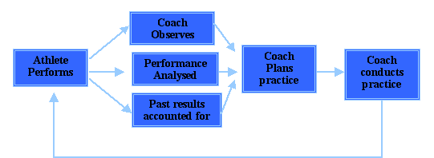
PARCS
(Performance Analysis Research and Consultancy in Sport)
Introduction
Fig.1. Schema of the coaching process (Franks et al, 1983).
Performance Analysis is the fulcrum of the coaching process and is a mechanism for research
into sport at ‘the coal face’ – many professional clubs and NGB’s employ Performance Analysts.

Slide 6
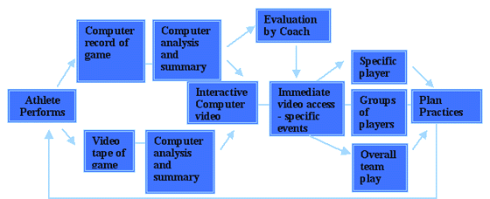
PARCS
(Performance Analysis Research and Consultancy in Sport)
Introduction
Fig.2 .A more complex schema of the coaching process
Performance Analysts must now be very confortable with digital video and computer
technology – These skills will be introduced to the students on IPPAS.

Slide 7

Aims
The main objective of the programme is to bring together expert staff from different universities (12) across Europe, and commercial software firms, to contribute to an intensive course in Performance Analysis of Sport (PAS) – 2 modules at Level 3, undergraduate (equivalent to 20 CATS each in the UK, or 10 ECTS each in Europe). The staff from the SME’s will contribute a pragmatic practical approach that will complement the academic delivery of the Universities’ staff. All will learn from each other and will be able to use these materials and resources when they return home, to improve their own courses.
The students (N=60 max) on the course will be recruited through the INSHS network and will have qualifications in sport (either 1 or 2 years of a degree or coaching qualifications), and are looking to increase their knowledge of analysis and feedback, perhaps with a view to applying for an MSc in PAS.

Slide 8
PARCS
(Performance Analysis Research and Consultancy in Sport)
UNIVERSITIES and COMPANIES TAKING PART (at the moment)
UNIVERSITY OF MIDDLESEX | Profs. Mike Hughes & Nic James
UNIVERSITY OF WEST HUNGARY, SAVARIA CAMPUS– | Dr. Henriette Dancs
UNIVERSITY OF LJUBLJANA | Dr. Goran Vuckovic
OTTO VON OTTO-UNIVERSITAT | Prof. Anita Hoekelmann
NTU, NOTTINGHAM | Athalie Redwood-Brown
UNIVERSITY OF VALENCIA | Prof. Jose Guzman
UNIVERSITY OF ZAGREB | Dr. Goran Sporis
UNIVERSITAT D'ALACANT | Prof. Jose Turpin
UNIVERSITY OF CHICHESTER | Dr. Matt Robins
UNIVERSITY OF TALINN | Dr. Boris Bazanov
UNIVERSITY OF WORCESTER | Prof. Derek Peters
UNIVERSITY OF CHESTER | Dr. Paul Worsfield
SME - SPORTSCODE | Christophe Duschesne
SME - FOCUS | Ian Donnelly

Slide 9
PARCS
(Performance Analysis Research and Consultancy in Sport)
Method
The partner universities will all contribute their respective expertise to the course, so the organisation of the modules, and the recruitment of potential students, will demand a high degree of multilateral cooperation between these 12 universities and the commercial enterprise.
The software company staff will introduce their generic data collection and analysis software and demonstrate its use with digital video. All staff will learn from each other and will be able to use these materials and resources when they return home, to improve their own courses.

Slide 10
PARCS
(Performance Analysis Research and Consultancy in Sport)
Method
The courses will enable the universities to develop and enhance, in conjunction with the software firm, new electronic methods of delivery, distance learning and assessment.
This will involve staff and students improving their communication skills through such software as Powerpoint, Skype, Adobe, Microsoft Excel, and so on, as well as the interactive software packages that we will deliver as the courses develop.
There will be as much ‘hands on’ experience as possible for the students, designing analysis systems for any sports in which they are interested, transferring these ideas into the generic software to enable data capture from video.
They will learn correct analysis methods to process these data and then use them to create storyboards for edited videos that tell the tale of the performance.
All students will have to make presentations as part of their assessments, these being projects based on their practical work

Slide 11
PARCS
(Performance Analysis Research and Consultancy in Sport)
Method
The courses will enable the universities to develop and enhance, in conjunction with the software firm, new electronic methods of delivery, distance learning and assessment. All the material and resources for the courses will be electronic, then all the students, and staff of course, will enhance their technological and computing knowledge through the use of the software packages such as FOCUS (EliteSportsAnalysis), Powerpoint, Skype, Adobe, Microsoft Excel, and so on.
These modules (equivalent to 20 CATS each in the UK, or 10 ECTS each in Europe and certified by Middlesex University) are delivered in a similar form at a number of the universities as part of sports degrees. This course will complement those courses, and will enable the students to gain access to MSc courses such as those run at UWIC, NTU Nottingham, Chester, Middlesex, Chichester, and the International MSc in PAS run by NTU, Otto von Guericke Universitat, Magdeburg and the University of Valencia.

Slide 12
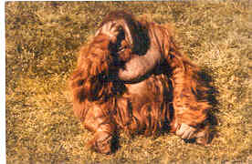
Day | The programme of lectures and other activities
1 (am) | Lecture: Introduction to performance analysis, purposes, stages, activities. (MDH– see section 4.7 for key to initials) Tutorial: Coursework: the task, use of the systems. (NJ)
1 (pm) | Lecture: Quantitative v qualitative analysis of performance. (HD) Lecture: Tactical and technical analysis. (ID)
2 (am) | Seminar: Technical effectiveness in team games. (GV, GC and BB) Seminar: Technical effectiveness in racket sports. (MDH, NJ, GV and ID)
2 (pm) | Seminar: Time-motion analysis -work-rate analysis. (AH, JT2) Lecture and Seminar: Designing systems. (MDH JJW, HD and NJ)
3 (am) | Lecture: Performance Indicators and Reliability (MDH) Seminar: Making a presentation - using Powerpoint. (GS)
3 (pm) | Tutorial: On the system designs (MDH, JJW and NJ)
4 (am) | Lecture: Motor Control (AH) Lecture: Learning and feedback (HD)
4 (pm) | Tutorial: FOCUS (ID, IC, MDH, NJ, JJW, HDT - ALL)
5 (am) | Tutorial: MovieMaker / IMovie / iDVD / etc., (ALL - NJ, IC, ID)
5 (pm) | Lecture: Performance Indicators. (MDH, JJW and NJ) Lecture: PI Tutorial on the designed systems. (MDH, JJW and NJ)
 | LOCAL CULTURE (Szombathely)
 | LOCAL CULTURE (Trip to Vienna)
Work
Programme
WEEK ONE

Slide 13
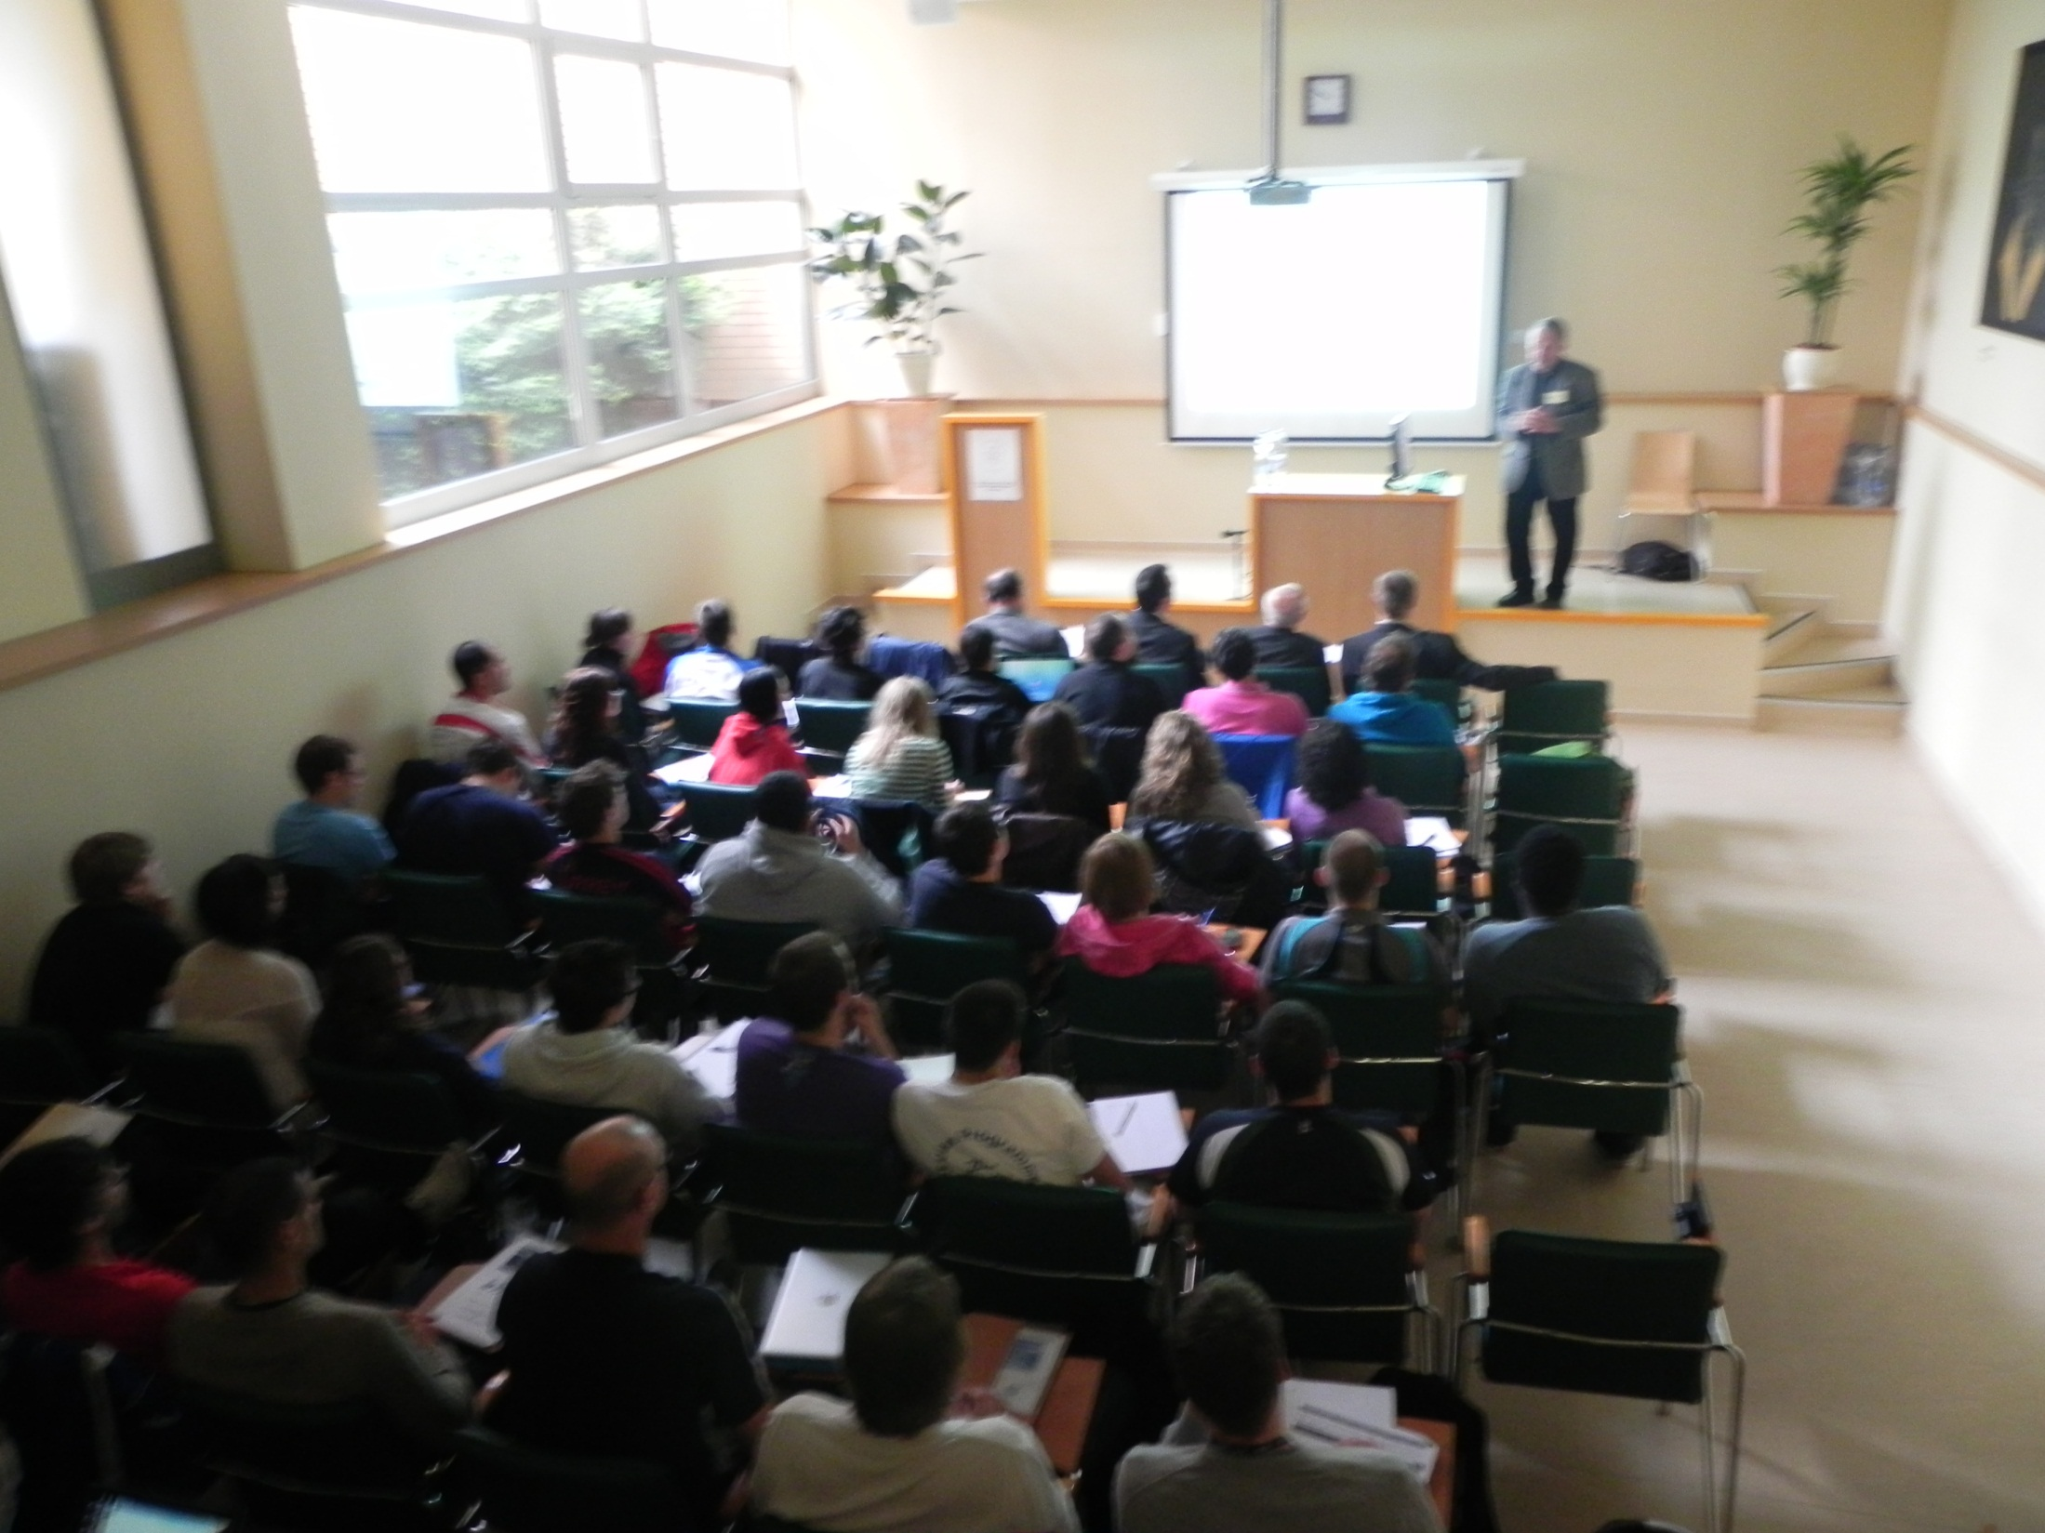
Day | The programme of lectures and other activities
6 (am) | Lecture: Variability in sports performance and time-motion analysis - Perturbations. (MR, MDH and NJ) Lecture: Momentum (MDH, JJW and NJ)
6 (pm) | Lab tutorial on computerised match analysis. (ID, IC, MDH, NJ, JJW, HD…. ALL)
7 (am) | Lecture: Rule changes in sport and technological advances (JJW) Tutorial: On the system designs and CW presentations (ID, IC, MDH, NJ, JJW, HD…ALL)
7 (pm) | Lecture: Using Prozone in soccer match analysis. (MDH, GS) Tutorial: Student problems (ID, IC, MDH, NJ, JJW, HD… ALL)
8 (am) | Lecture: Qualitative Biomechanics (MR, JT) Seminar: Using SiliconCoach, Quintic and Dartfish (JT, NJ, MR, JJW)
8 (pm) | Tutorial: The future of Performance Analysis (ALL) Seminar: Employment and further training opportunities. (ALL)
9 (am) | Student edited videos : >3 hours (ALL)
9 (pm) | Student edited videos : >3 hours (ALL)
10 (am) | Student presentations. (ALL)
10 (pm) | Student presentations. (ALL)
 | Both pieces of coursework will be submitted electronically to Prof. Mike Hughes on the last day of the respective module.
 | KEY. am: – 0900 – 1200; pm: – 1400 - 1700
Work
Programme
WEEK TWO
HARD!!!

Slide 14
PARCS
(Performance Analysis Research and Consultancy in Sport)
………BUT IT IS
NOT
ALL
HARD WORK…..

Slide 15
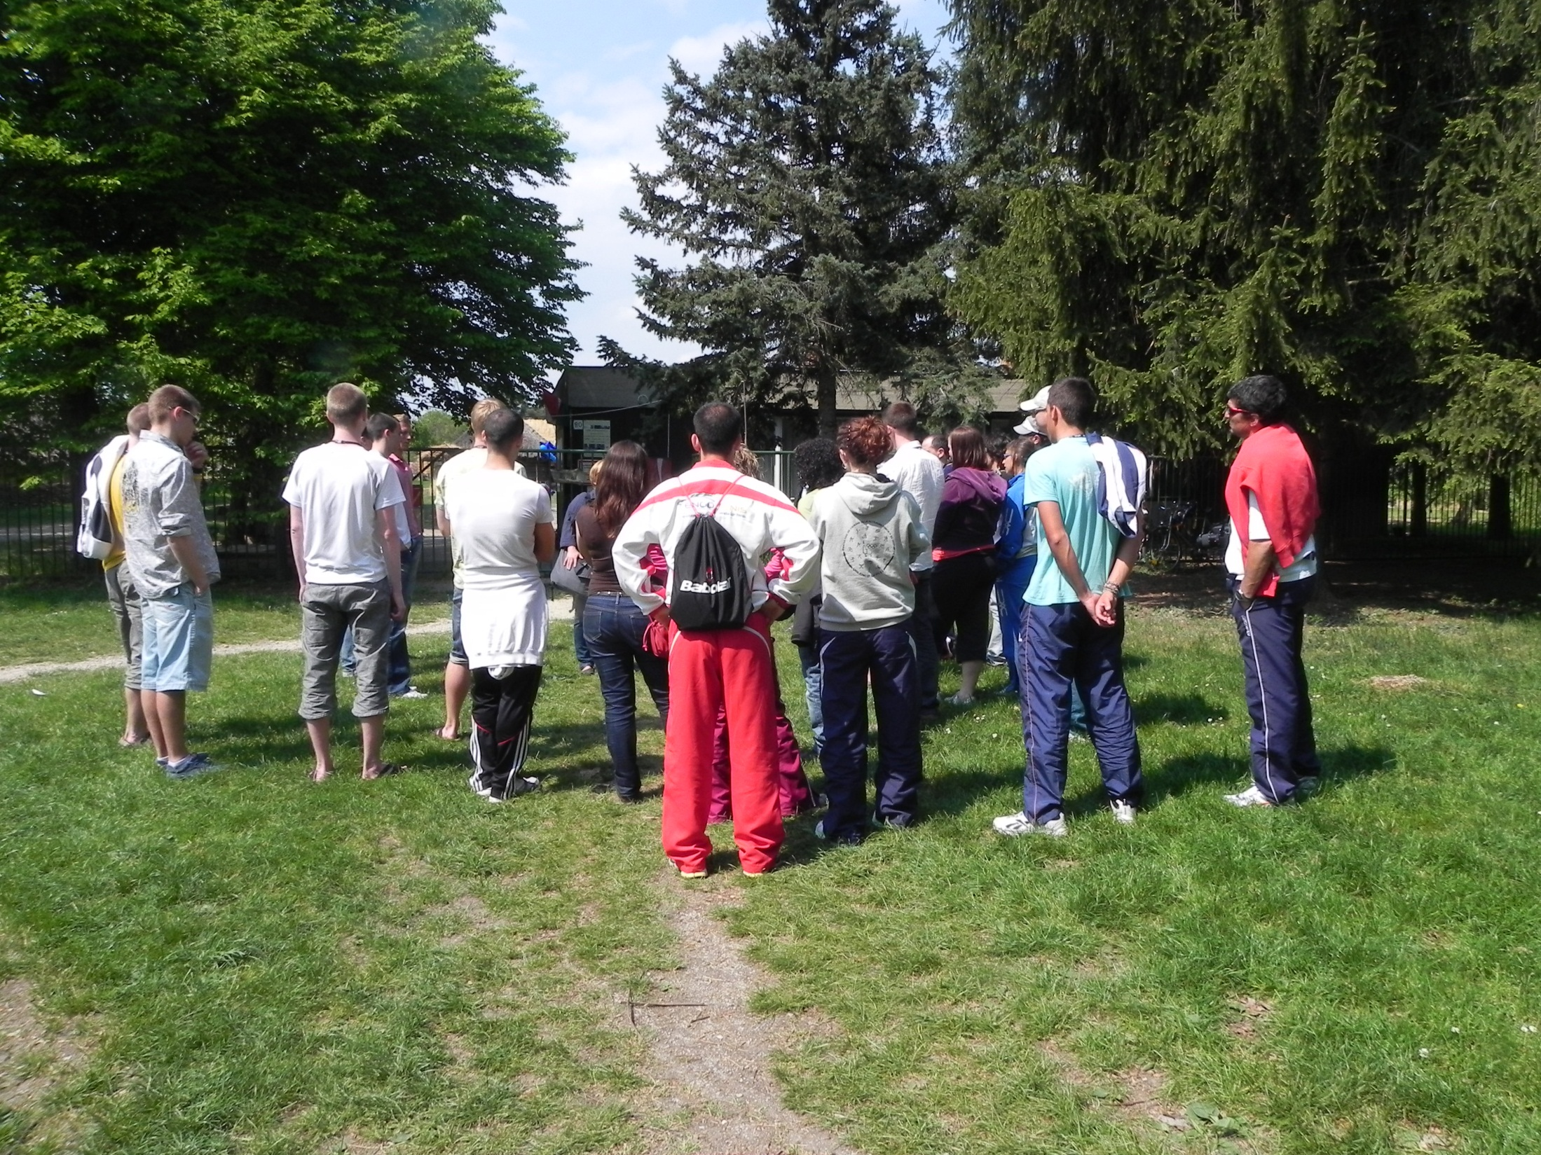
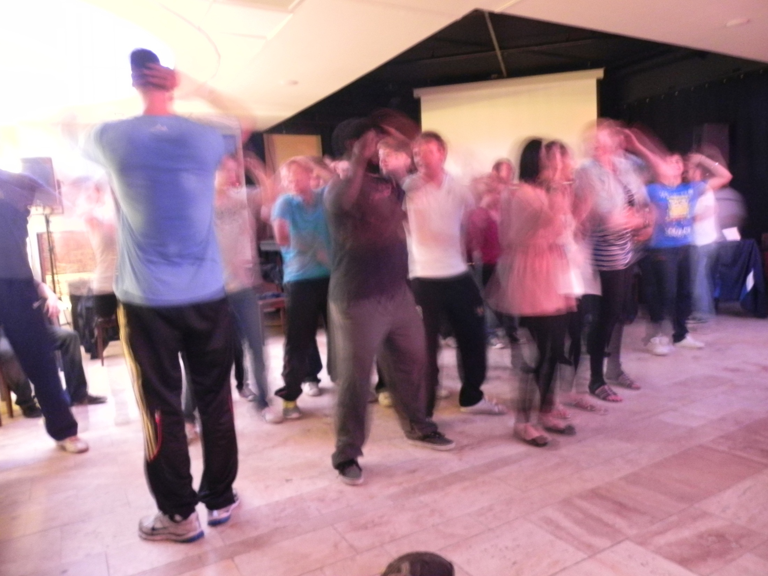
PARCS
(Performance Analysis Research and Consultancy in Sport)
SOCIAL PROGRAMME
Monday 25th April:- Traditional Hungarian Easter Programme – Open air Village Museum - 1400
Saturday April 30th – Day Trip (0930) to Lake Balaton ( Szigliget- Badacsony- Tihany) ,
2000 Evening Party - Theatre Lounge
Tuesday 26th | Wednesday 27th | Thursday 28th | Friday 29th | Sunday May 1st
21.30 International ‘Snack’ Party and Champions League Theatre Lounge | 21.00 Champions League and Party Theatre Lounge | Volleyball, B’ball and/or 6-a-side Party Games Theatre Lounge. | 1430 Goulasch Party 2000: Retro Party Evening Banya Club | 2030 Mayday Party Theatre Lounge
Monday 2nd | Tuesday 3rd | Wednesday 4th | Thursday 5th | Friday 6th
16.30 Buk – Wellness and golf 21.00 Hungarian Dance Party – Theatre Lounge | 18.00 Kőszeg sightseeing 21.00 Champions League -Evening Party Theatre Lounge | 2030 Champions- League -Party Theatre Lounge Disco | 22.00 Evening Party- Theatre Lounge

Slide 16
PARCS
(Performance Analysis Research and Consultancy in Sport)
4 IMPLEMENTATION
NEXT STEPS:-
EACH UNIVERSITY ORGANISER RECRUITS 5 STUDENTS (PLUS RESERVES?) WHO WISH TO SHARE THIS UNIQUE INTERNATIONAL EDUCATIONAL EXPERIENCE.
EACH STUDENT MUST COMMIT TO 2 WEEKS IN HUNGARY from 5th – 16th May 2013
EACH STUDENT MUST PAY A DEPOSIT OF 50 euros.
EACH STUDENT WILL HAVE TRAVEL, ACCOMMODATION AND 3 MEALS PER DAY PROVIDED, PLUS A FULL SOCIAL PROGRAMME.
EACH STUDENT THAT PASSES EACH MODULE WILL RECEIVE A CERTIFICATE (10 ECTS EACH) PROVIDED BY THE UNIVERSITY OF MIDDLESEX.
ANY WITHDRAWALS WILL FORFEIT THEIR DEPOSITS.

Slide 17
PARCS
(Performance Analysis Research and Consultancy in Sport)
4 IMPLEMENTATION
NEXT STEPS:-
WE NEED THE NAMES AND PASSPORT DETAILS, AND OTHER PERSONAL DATA (SEE THE ‘STUDENTINFO.XLS’ FILE) BY DECEMBER 21st SO WE CAN GET FLIGHTS AS CHEAPLY AS POSSIBLE – PLEASE COPY TO PROF. DANCS.
WE ALSO NEED DETAILS OF THE STAFF COMING (SEE ‘STAFFINFO.XLS’ FILE) BY THE SAME DATE.
WE CAN ONLY PAY THE EXPENSES AND ACCOMMODATION OF ONE MEMBER OF STAFF PER UNIVERSITY – EXTRA STAFF CAN GET HELP THROUGH ERASMUS?

Slide 18
PARCS
(Performance Analysis Research and Consultancy in Sport)
In conjunction with
University of West Hungary, Szombathely, Hungary
IN CONCLUSION:-
60 students from 12 universities from all over Europe gather in Hungary for 2 weeks, May 5th – May 16th, 2013.
World-Leading Performance Analysis Staff deliver 2 academically certified modules (Level 3).
Travel, accommodation and all food, paid for by the ERASMUS grant.
FULL social, sporting and cultural programme, including days out to Vienna or Lake Balaton.
Cost to students - 50 euros in total.

Slide 19

PARCS
(Performance Analysis Research and Consultancy in Sport)
In conjunction with
University of West Hungary, Szombathely, Hungary
PARCS
(Performance Analysis Research and Consultancy in Sport)
DO YOU WANT TO BE A PART OF THIS?
DECIDE NOW,
AND LET YOUR MEMBER OF STAFF KNOW AS SOON AS POSSIBLE –
ONLY 5 PLACES!!!!

Slide 20
PARCS
(Performance Analysis Research and Consultancy in Sport)
THANK
YOU
FOR
YOUR
ATTENTION
I look forward to seeing you in Hungary at Easter
Mike Hughes

